Slide 1
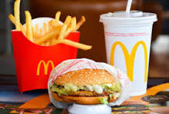
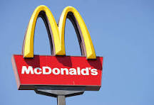
Mc. Donalds
Sanav Rajeev

Slide 2
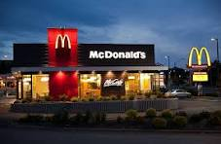
Background
The founder of Mc. Donalds was Ray Kroc.
Ray Kroc officially joined Mc. Donalds in 1954.

Slide 3
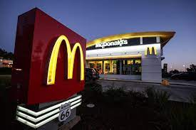
Industry
Mc. Donald’s industry was fast food.

Slide 4

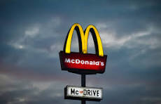
Is Mc. Donalds publicly traded?
Yes Mc. Donalds is publicly traded.
One share is $304.34

Slide 5
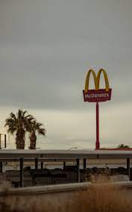
Producing Revenue
Yes, Mc. Donalds is definitely generating revenue.
$23.2 billion

